Slide 1
3D Image Segmentation and Quantification of Lysosomes
29/1/2025

Slide 2
GUI CELLS

Slide 3
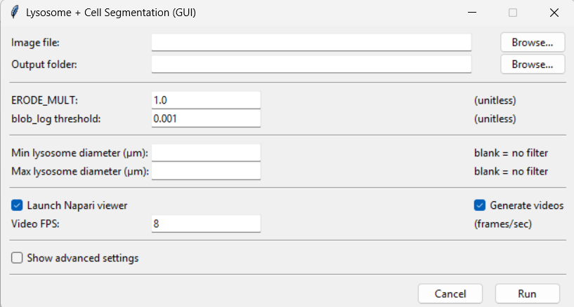
GUI WITHOUT ADVANCED SETTINGS
1
2
3
4
5
6
7
8
9
10

Slide 4
Inputs and buttons
1) Image file
Text box
Shows the full path of the file you selected (.czi, .tif, .tiff).
Browse… (button)
Opens a file picker. When you choose a file, the GUI also auto-suggests an output folder (same directory as the image + timestamp) if the output field is empty.
2) Output folder
Text box
Where all outputs are written:datasets, videos and pictures
Browse… (button)
Lets you choose a parent folder.
The script then makes a new timestamped folder inside it (based on the image name).
3) ERODE_MULT
ERODE_MULT (input): A multiplier / additive factor used in your auto morphology stage.
Units: unitless (it becomes a voxel radius for erosion).
Effect: higher values generally shrink the mask more (more erosion).
For neurites: too high will break thin branches.
Typical:
Image with little noise: 0-2
Image with a lot of noise: >=3

Slide 5
Inputs and buttons
4) Blob_log threshold
Input:
Controls how strict the lysosome detection is using the function blog_log.It’s basically the minimum “blob response” required to call something a blob.
Units: unitless.
Effect:
Lower threshold → more detections (including noise)
Higher threshold → fewer detections (may miss lysosomes)
Typical: 0.001–0.05, depends on intensity / noise.
5) Min lysosome diameter(µm)
Input:
The minimum diameter of the lysosomes.
Units: micrometers (µm)

Slide 6
Inputs and buttons
6) Max lysosome diameter(µm)
Input:
The maximum diameter of the lysosomes .
Units: micrometers (µm)
7) Launch Napari viewer (checkbox)
If checked: opens napari, adds layers.
If unchecked: the script runs headless (still saves outputs).
Affects: only visualization (not segmentation output itself).
8) Generate videos (checkbox)
If checked: writes MP4/GIF outputs(fused overlays, side-by-side raw vs fused)
If unchecked: no videos are generated.
Affects: only outputs (not segmentation).
9) Video FPS
INPUT: Frames per second for the MP4/GIF writers.
Units: frames/second
Affects: playback speed only.

Slide 7
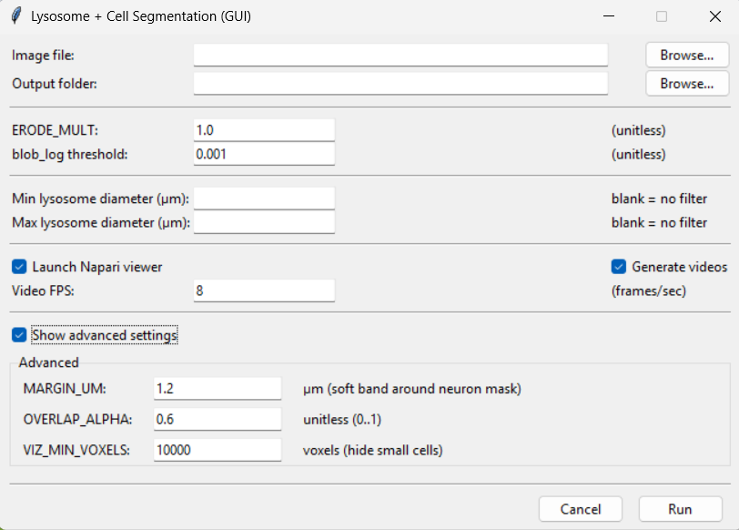
GUI WITH ADVANCED SETTINGS
10
11
12
13
14
15

Slide 8
Inputs and buttons
10) Show advanced settings (checkbox)
Toggles visibility of the advanced panel.
11) MARGIN_UM (µm)
Soft distance band around the neurite mask; helps classify lysosomes near the border as “inside”.
Units: micrometers (µm)
12) OVERLAP_ALPHA (0….1)
Minimum fraction of the lysosome sphere that must overlap the neurite mask to be “inside”.
Units: unitless fraction
13) VIZ_MIN_VOXELS (voxels)
Minimum component size (voxel count) to keep for visualization/IDs; smaller ones are removed.
Units: voxels
Bottom buttons
14)Cancel:Closes the GUI and exits the scrip.
15)Run:Validates inputs and run the script.

Slide 9
AXONS

Slide 10
SKELETONIZE 3D
It takes a 3D binary object (your neurite mask) and turns it into a 1-voxel-thick “centerline” that preserves the object’s connectivity and overall shape (topology), as much as possible.
Input: a 3D boolean volume mask (True = object, False = background).
Output: another 3D boolean volume skel where:
What it does conceptually
skel is a “thin” version of the object.
The structure is reduced to its medial axis / centerline.
Branches remain branches; connections remain connected.
For neurites, this is great because you can:
find endpoints and branch points
estimate local direction at endpoints
connect broken segments by reasoning on a simplified structure

Slide 11
SKELETONIZE 3D
It’s a rule-based thinning that keeps topology.
What “topology-preserving” means practically
If your original mask has:
one connected neurite network → skeleton tends to remain one connected network
a branch → skeleton keeps the branch
a loop → skeleton keeps a loop (often as a ring-like centerline)
It tries hard not to introduce new disconnections.

Slide 12
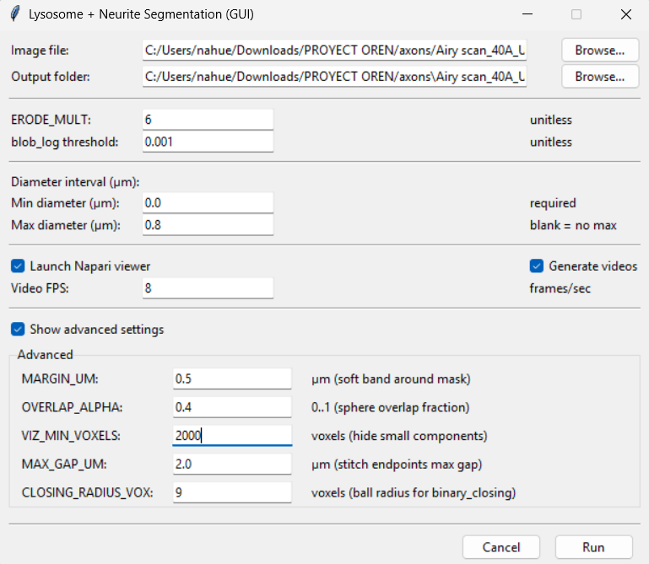
GUI
1
2

Slide 13
SHOW ADVANCED SETTINGS
1) MAX_GAP_UM(µm)
This is the maximum distance (in microns) that the program is allowed to jump across to connect two broken neurite ends.
Small value → only connects very small breaks (safer, fewer false connections)
Large value → connects bigger breaks (more aggressive, but can connect the wrong branches)
Micron (µm) is a real-world distance. So max_gap_um = 2 means:
“If two neurite ends are within 2 µm, I’m allowed to draw a bridge.”
How it affects results
Too low: real breaks stay disconnected → neurites look fragmented.
Too high: “false bridges” appear → branches that are close but unrelated get connected.
Units: micrometers (µm)
End A
GAP =2 UM
End B
If gap ≤ max_gap_um → program MAY connect them
If gap > max_gap_um → program will NOT connect them

Slide 14
SHOW ADVANCED SETTINGS
2) CLOSING RADIUS VOX(voxels)
This controls a smoothing/repair operation on the neurite mask called “closing”.
Closing does two things:
fills small holes inside the neurite mask
connects small gaps between nearby pixels/voxels
Units: voxels
CLOSING_RADIUS_VOX is the size of the “repair brush”, measured in voxels (image grid units).
Voxel = one 3D pixel in your image volume.
ball(N) means a 3D “sphere brush” with radius N voxels.
For example N = 3 voxels
BEFORE
AFTER
How it affects results
Small radius (e.g. 0–9): light cleanup; preserves fine branches.
Large radius (> 9): heavy cleanup; can merge nearby branches or thicken neurites too much.
1
2
3
3 VOXELS

Slide 15
FILES: -Airy scan_40A_UAS-TMEM-HA_axon_0h_again_2_051222 -Airy scan_40A_UAS-TMEM-HA_axon_0h_again_3_051222 -Airy scan_40A_UAS-TMEM-HA_axons_6h_1_150123 -Airy scan_40A_UAS-TMEM-HA_axons_8h_1_150123 -Airy scan_40A_UAS-TMEM-HA_axons_8h_2_150123 -Airy scan_40A_UAS-TMEM-HA_axons_8h_4_150123

Slide 16
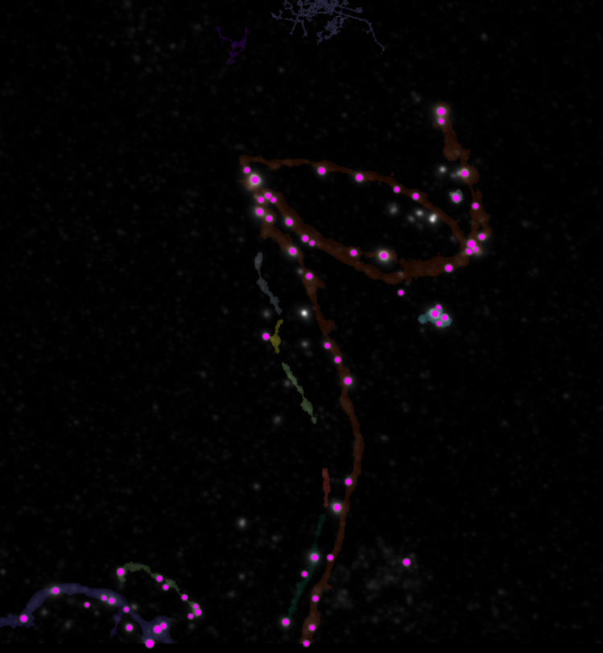
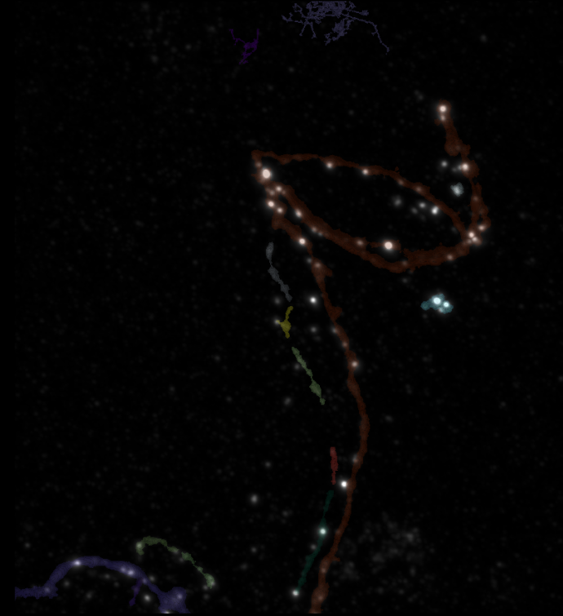
0H 2
Erosion = 6
Thresholding = 0.001
margin um = 0.5
overlap alpha = 0.4
viz min voxels = 2000
CLOSING = 4
max_gap_UM = 2

Slide 17
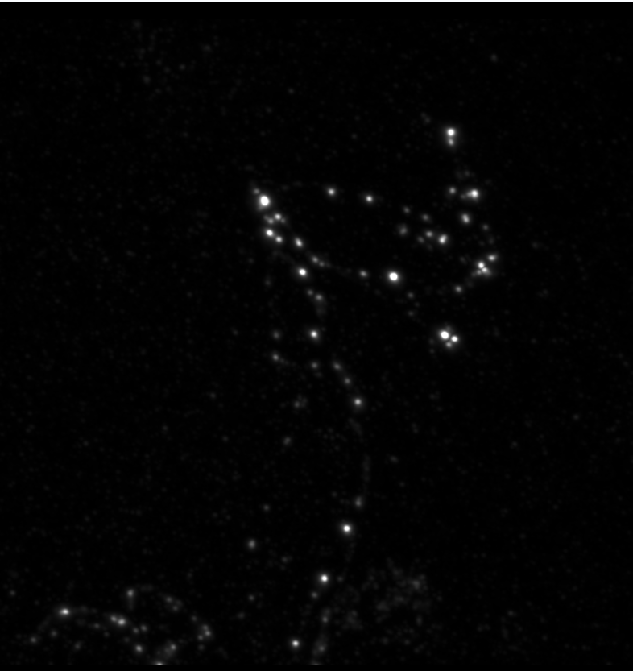
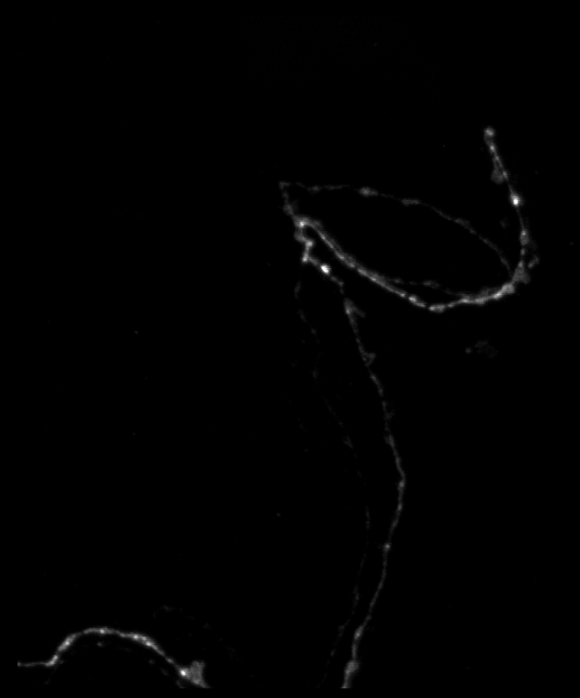
0H 2

Slide 18
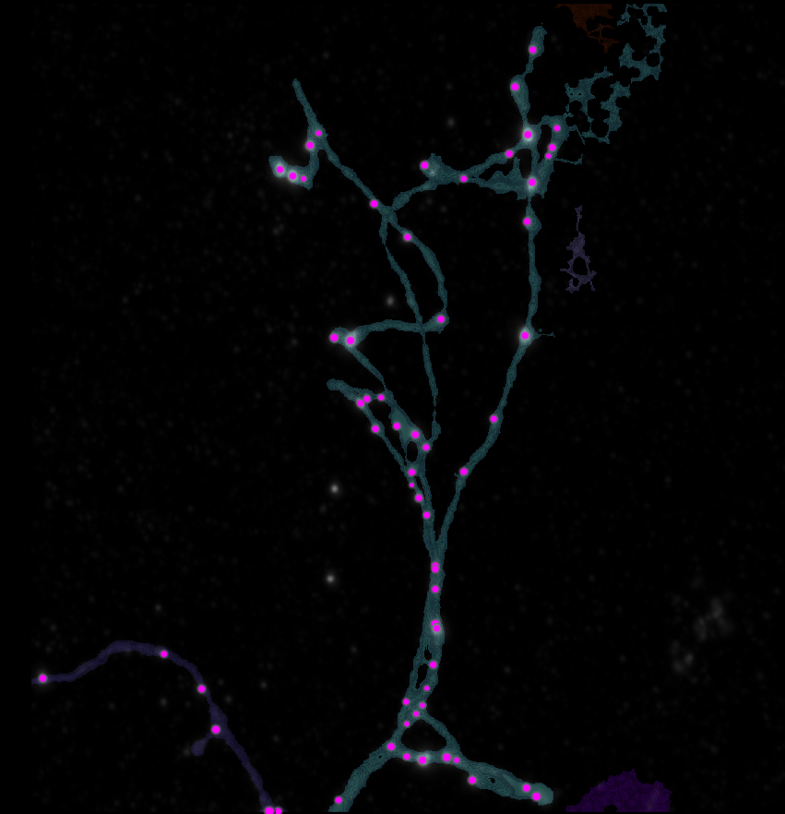
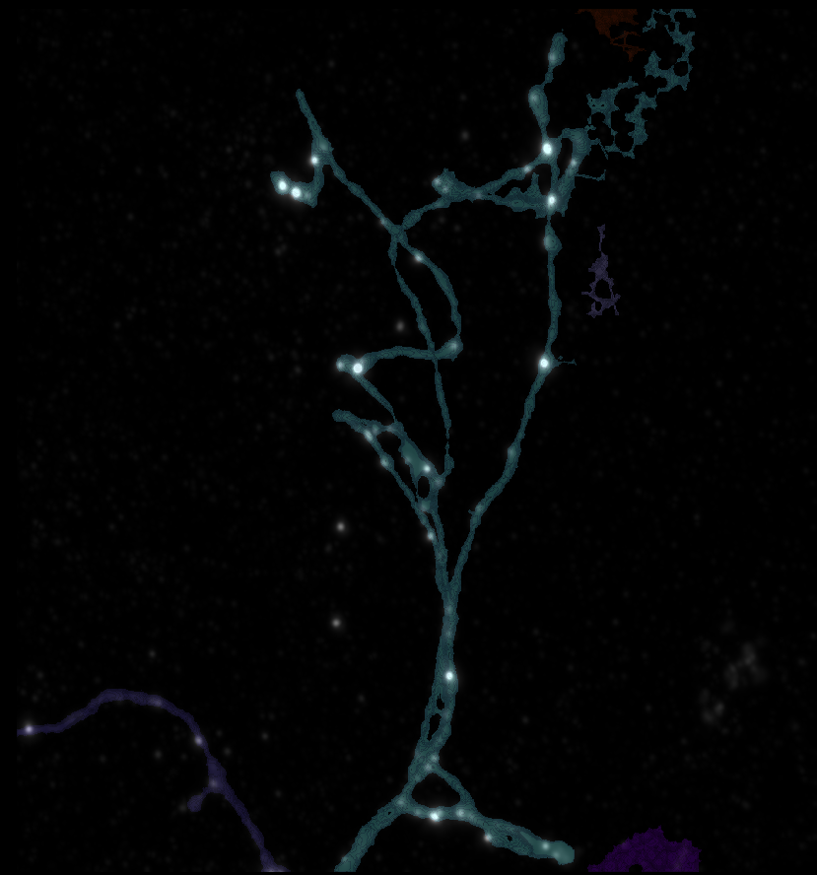
0H 3
Erosion = 4
Thresholding = 0.001
margin um = 0.5
overlap alpha = 0.4
viz min voxels = 2000
CLOSING = 9
max_gap_UM = 2

Slide 19
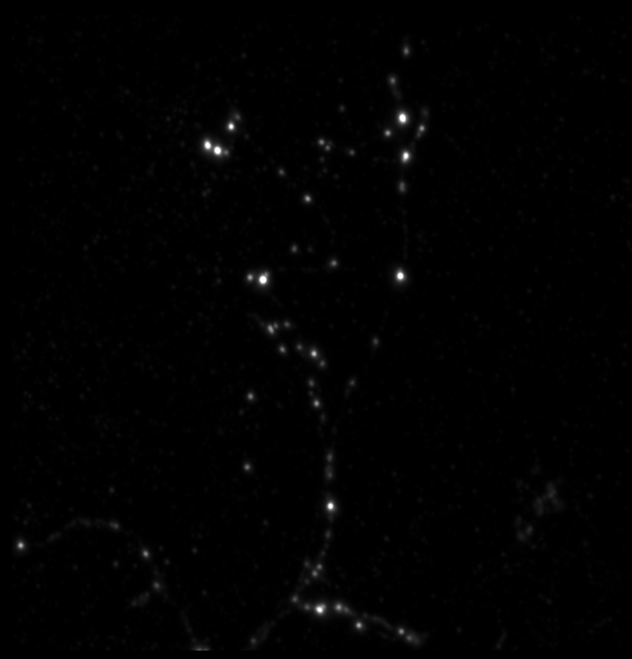
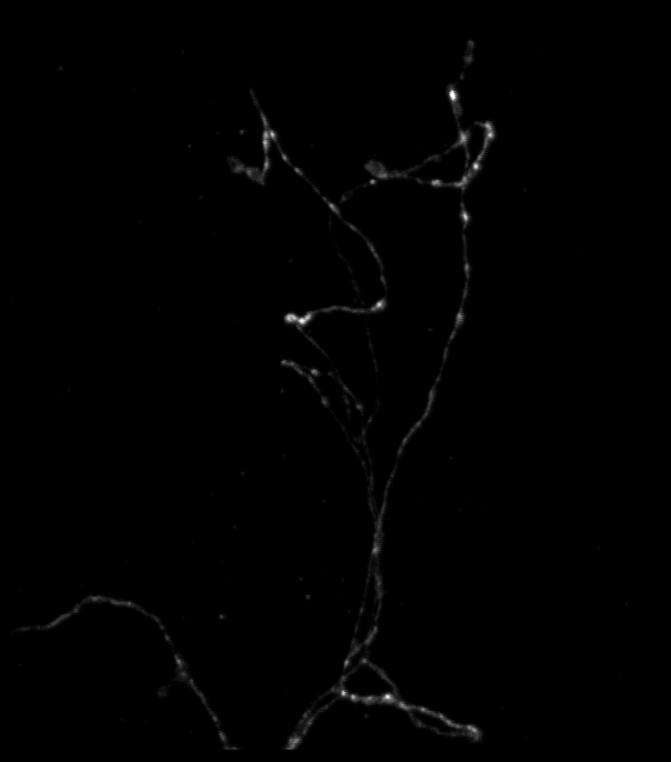
0H 3

Slide 20
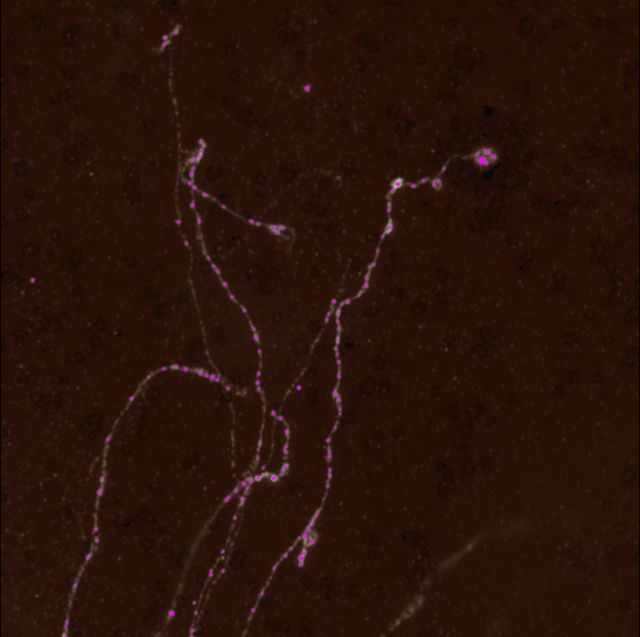
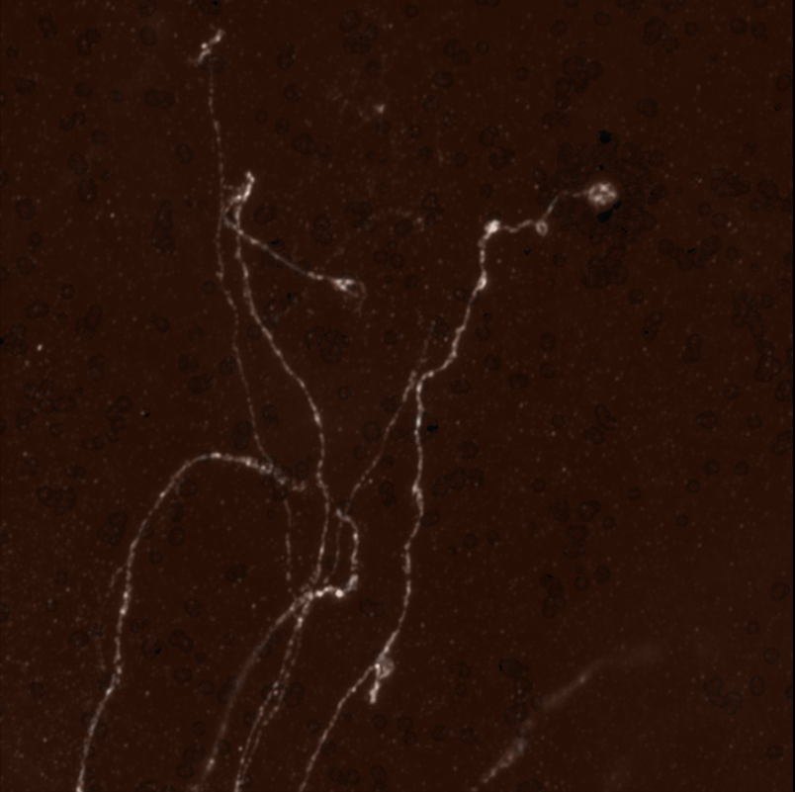
6H 1
Erosion = 15
Thresholding = 0.01
margin um = 0.5
overlap alpha = 0.4
viz min voxels = 2000
CLOSING = 2
max_gap_UM = 2.5

Slide 21
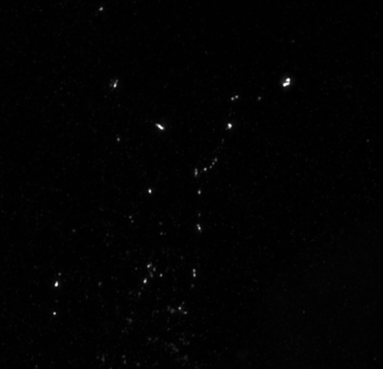
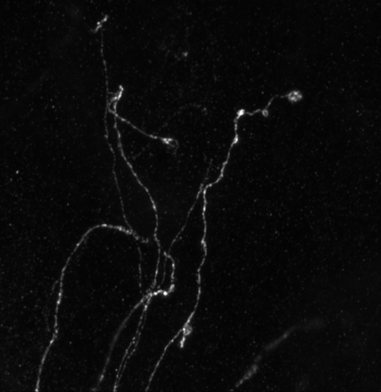
6H 1

Slide 22
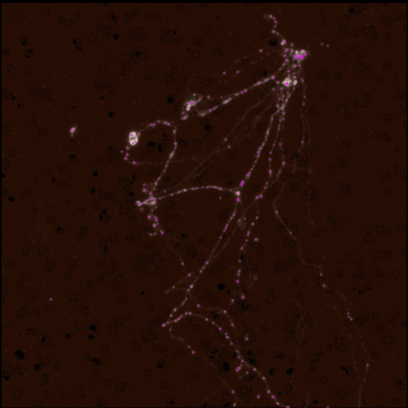
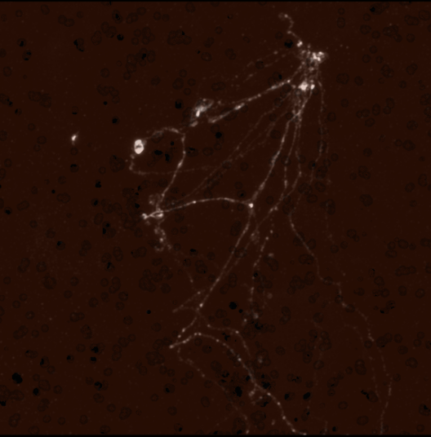
8H 2
Erosion = 11
Thresholding = 0.01
margin um = 0.5
overlap alpha = 0.4
viz min voxels = 2000
CLOSING = 4
max_gap_UM = 2.5

Slide 23
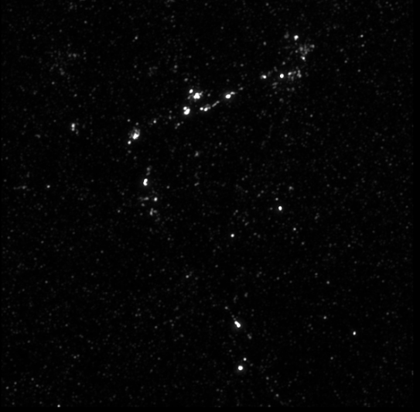
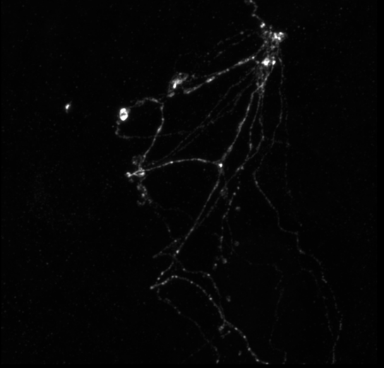
8H 2

Slide 24
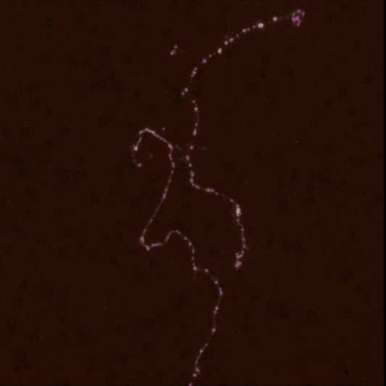
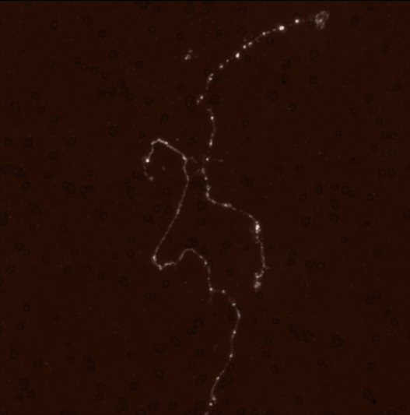
8H 4
Erosion = 14
Thresholding = 0.01
margin um = 0.5
overlap alpha = 0.4
viz min voxels = 2000
CLOSING = 3
max_gap_UM = 2.5

Slide 25
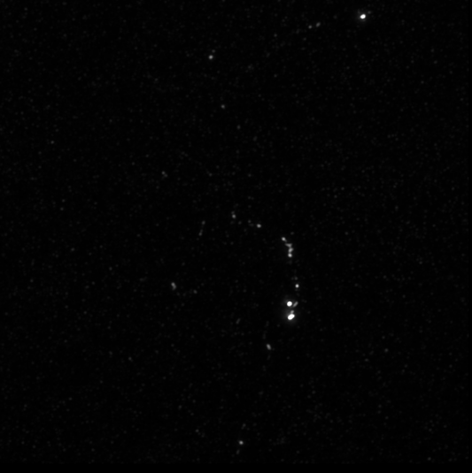
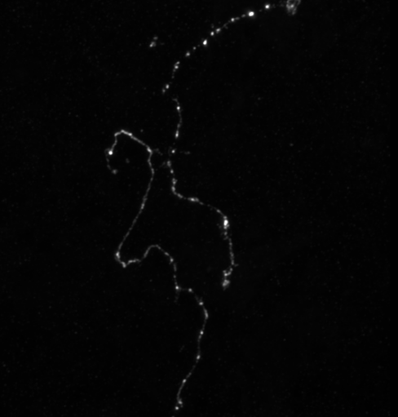
8H 4

Slide 26
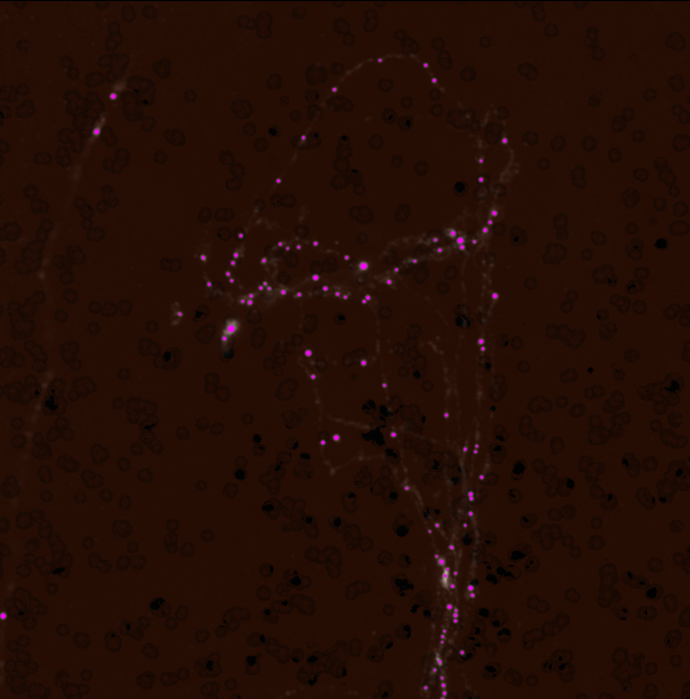
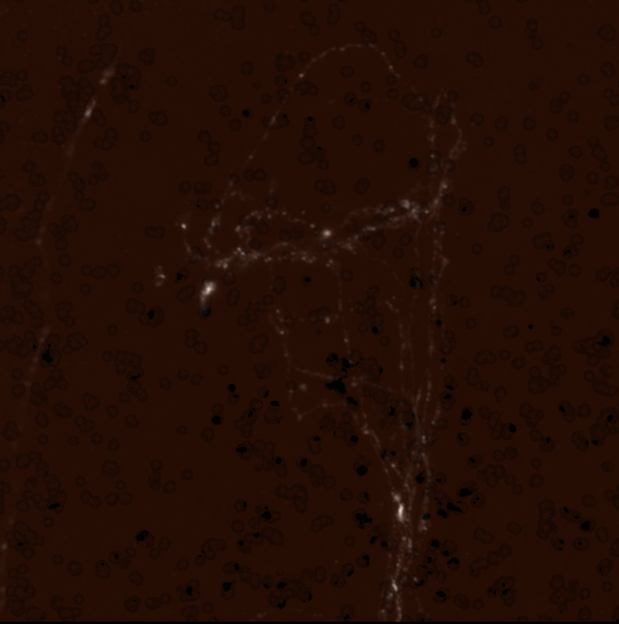
8H 1
Erosion = 12
Thresholding = 0.01
margin um = 0.5
overlap alpha = 0.4
viz min voxels = 2000
CLOSING = 1
max_gap_UM = 2.5

Slide 27
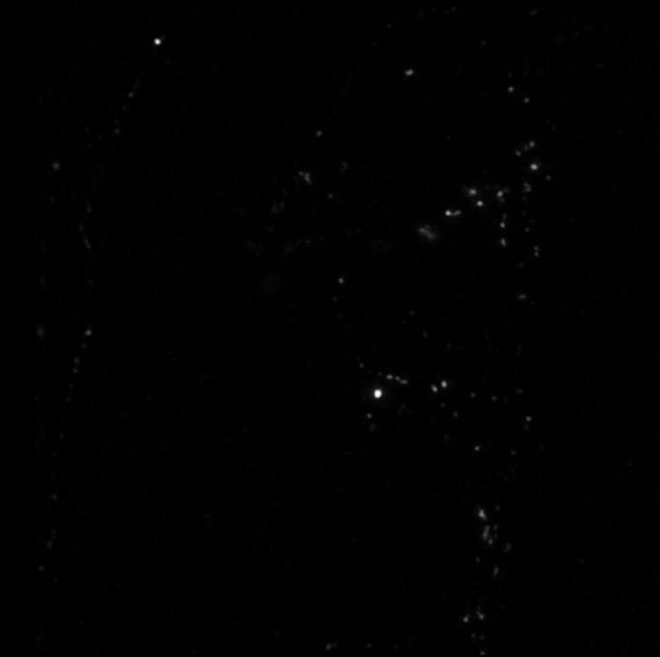
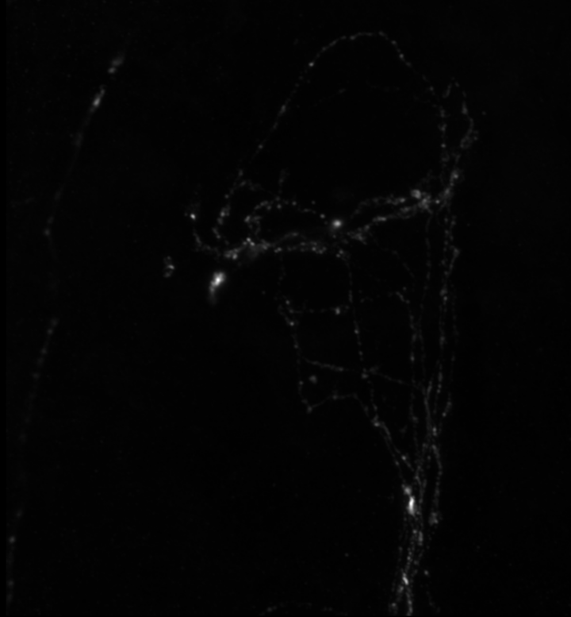
8H 1

